Slide 1

FFPM 241

Slide 2
Fiarahabana Apostolika

Slide 3
Fisaorana sy Fiderana an' Andriamanitra

Slide 4
Salamo 68:19-21

Slide 5
FFPM 33

Slide 6

Vavaka

Slide 7
Fankalazana ny Tenin' Andriamanitra

Slide 8
Fotoana ho an'ny ankizy sy ny Tanora

Slide 9
Ohabolana 13:3

Slide 10
FFPM 788

Slide 11
Vavaka

Slide 12

VAKITENY
I Samoela 7:2-14 Marka 4:35-41 Asa 18:5-11

Slide 13
FFPM 295

Slide 14
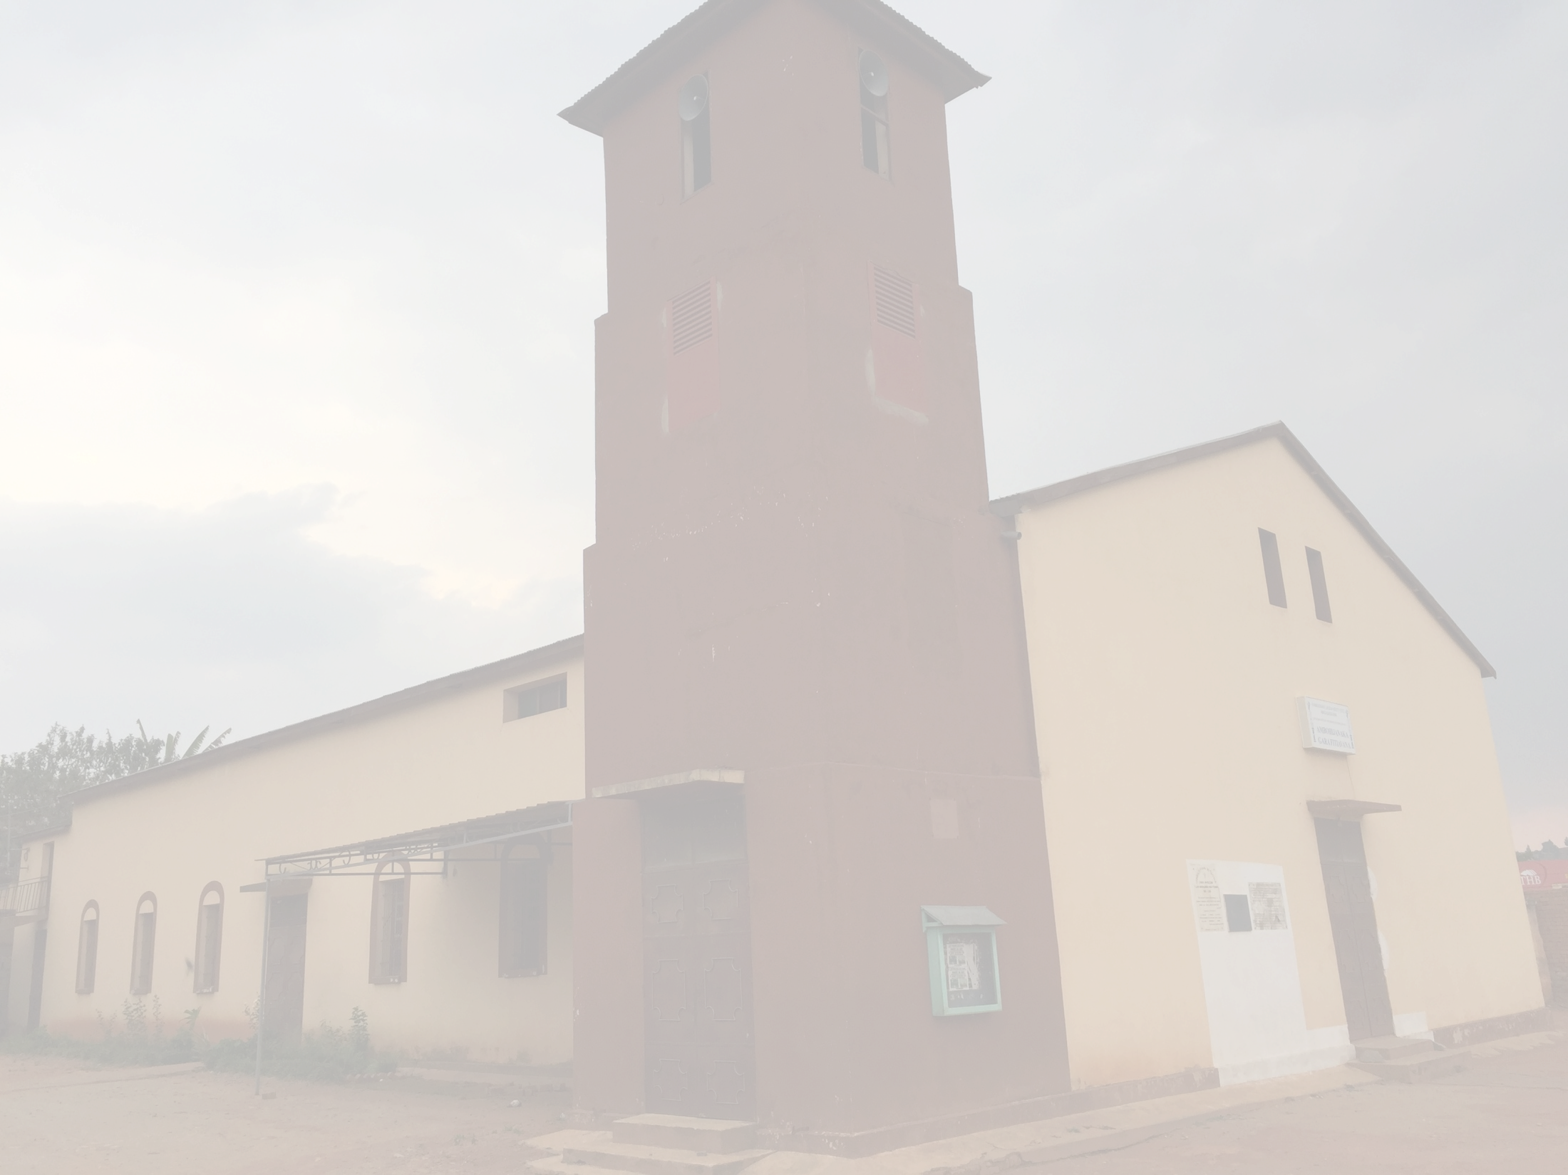
Toriteny

Slide 15

Feon-javamaneno

Slide 16
Vavaka sy Rainay

Slide 17
Fanekem-pinoana voalohany

Slide 18
Feon-javamaneno

Slide 19
Asan' Andriamanitra

Slide 20
Raharaham-piangonana

Slide 21
Rakitra

Slide 22
FFPM 303

Slide 23
Fanolorana ny Rakitra

Slide 24
Asa Vavolombelona

Slide 25
Batisa

Slide 26
FFPM 248

Slide 27
Rakim-pifaliana

Slide 28
SALAMO 103

Slide 29
Vavaka

Slide 30

Tsodrano

Slide 31
FFPM 332

Slide 32
Trinite

Slide 33
Firavana

Slide 34

Fandraisana Fanasan'ny Tompo

Slide 35
Fanehoana

Slide 36
ANTEMA 1

Slide 37
ANTEMA 1

Slide 38
antema_1

Slide 39
Fanorenana

Slide 40
Vavaka

Slide 41
Fanamasinana

Slide 42
Fanasana

Slide 43
Fizarana

Slide 44
FFPM 254

Slide 45
Fandraisana

Slide 46
Fanati-pisaorana & Fanangonana Kapoaka

Slide 47
FFPM 170

Slide 48
Hafatra

Slide 49
Tsodrano

Slide 50
Trinite

Slide 51
FFPM 267

